Slide 1
From Decision Trees to
Random Forests

Slide 2
Definition
Random forest (or random forests) is an ensemble classifier that consists of many decision trees and outputs the class that is the mode of the class's output by individual trees
Leo Breiman and Adele Cutler and "Random Forests" is their trademark
The method combines Breiman's "bagging" idea and the random selection of features
Notes:
Random forest (or random forests) is an ensemble classifier that consists of many decision trees and outputs the class that is the mode of the class's output by individual trees
The term came from random decision forests that was first proposed by Tin Kam Ho of Bell Labs in 1995.
The method combines Breiman's "bagging" idea and the random selection of features.

Slide 3
Recall Classification (Regression) Tree
Divide and conquer
Partition data one variable at a time
Recursive over same variable to get highly non-linear combinations of features
Decision Node: split data depending on value of the attribute
Leaf Node: label data (or estimate data) according to most likely class (value)

Slide 4
Recall Classification (Regression) Tree
Model:
Y=f_{leaf} (X) for decisions on X lead to that leaf partition
Objective: minimize error/misclassifications
Algorithm:
initialize a ROOT node
for each unsplit node
search all x_{i} for possible partitions
choose best x_{i}
until leafs are pure or tree is deep enough

Slide 5
Recall Classification (Regression) Tree
Parameters:
1.criterion for splitting a node
choose best x_{i} w.r.t. objective function
2.criterion to stop splitting
choose a minimum number of data points that fall to each leaf
choose a maximum tree depth
require a minimal improvement
3.prune tree activate

Slide 6
Recall Classification (Regression) Tree
Issue: deeper tree => less points fall to a leaf
too few data points => unreliable partition
too many => another split could improve model
Solution: Cross Validation helps determine depth
Solution: Pruning helps avoid overfitting
Issue: Decision boundaries are sharp and perpendicular to input dimensions
Solution: take more than 1 variable at time
Better: bootstrap and aggregrate

Slide 7
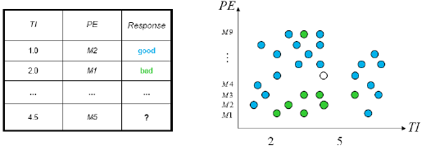
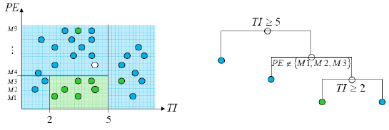
Decision Trees
Simple dataset with two predictors
Greedy, recursive partitioning along

Slide 8
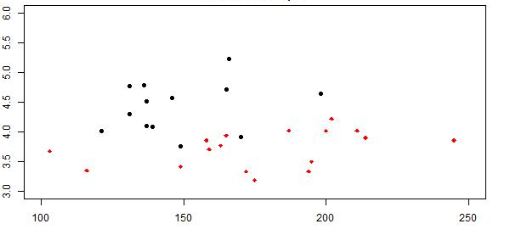
Recall Idea: Dividing and conquering
Where to split so that classification or regression can be
easy?
ERA
Number of Team HRs 2012

Slide 9
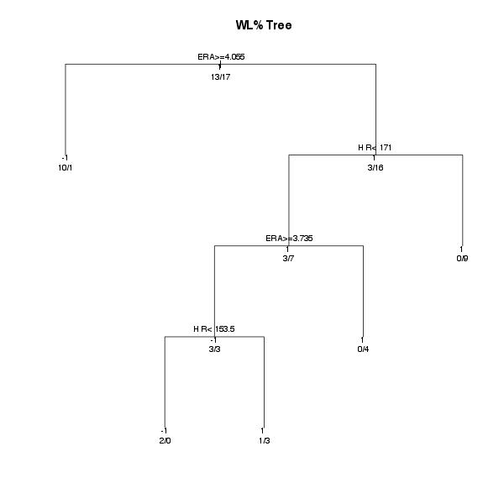
A Classification Tree on WL%
10/1 case of -1/1 class
ERA
Number of Team HRs 2012

Slide 10
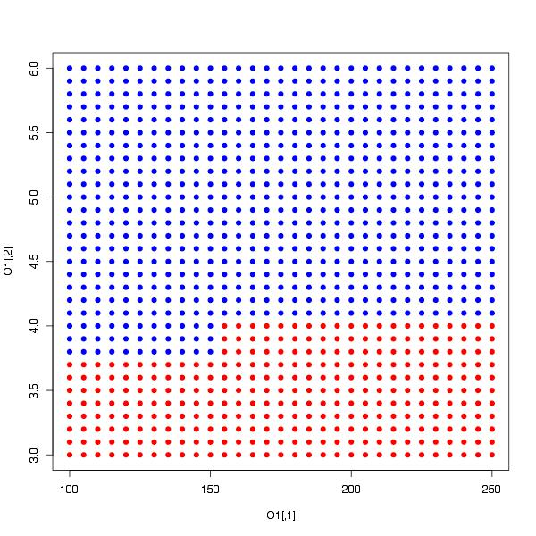
Decision Tree Issue
non-linear decision boundary, but with sharp corners (can’t take diagonal partitions)
blue=>point classified
as WL% < .50
ERA
red=>point classified
as WL% > .50
Number of Team HRs 2012

Slide 11
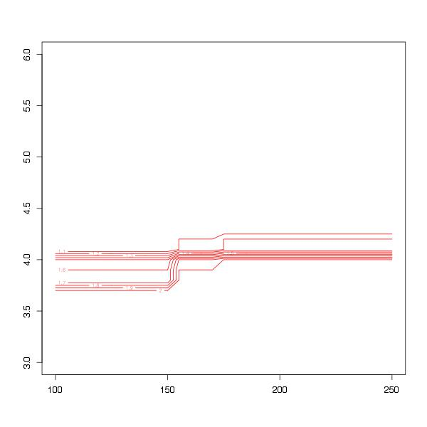
Classification Tree w/Bootstrapping
10 samples of data used for 10 trees
get average
classification
at each grid
point,
make counter
plot of average
Tree_Ex1_part4.R
ERA
Number of Team HRs 2012

Slide 12
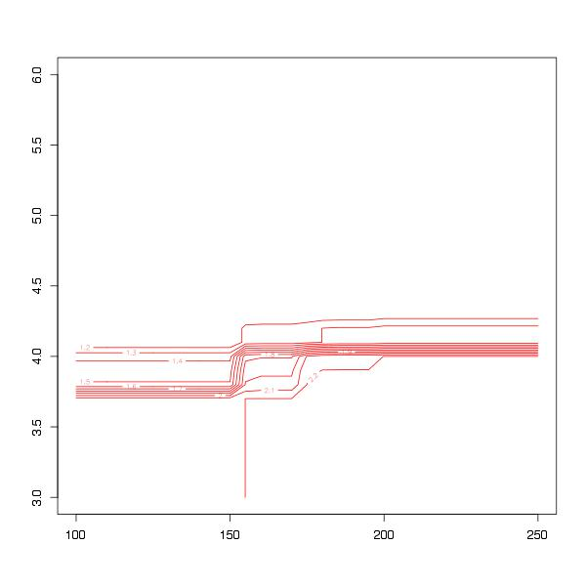
Classification w/ Bootstraps
100 samples => softer boundary
get average
classification
at each grid
point
make counter
plot of average
ERA
Number of Team HRs 2012

Slide 13
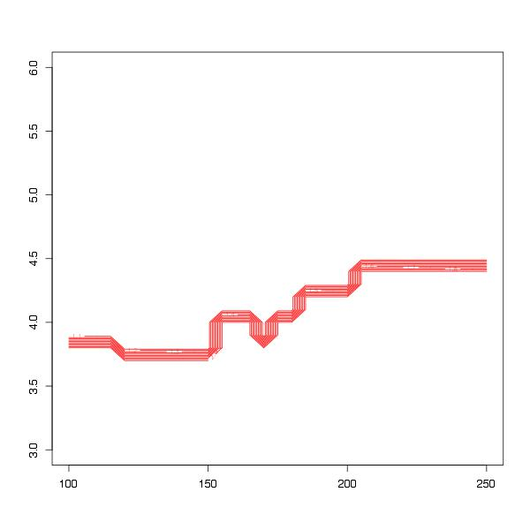
Random Forest
“Bagging”=bootstrap & aggregate samples, gives soft and highly flexible boundary
ERA
Number of Team HRs 2012

Slide 14
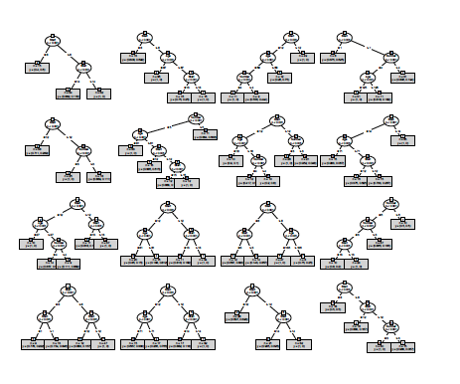
Construction of Random Forest
Over and above recursive partitioning do:
Take Bootstrap samples of observations (ntree)
Fit a regression/classification tree to each sample
During construction, choose the best split only from a subset of features (mtry)
Result: an ensemble of diverse trees
Aggregating over an ensemble reduces prediction variance
Notes:
Feature selection:
-Select a minimum set of features such that the probability distribution of different classes given the values for those features is as close as possible to the original distribution given the values of all features
-reduce # of patterns in the patterns, easier to understand

Slide 15
Algorithm
Each tree is constructed using the following algorithm:
Let the number of training cases be N, and the number of variables in the classifier be M
We are told the number m of input variables to be used to determine the decision at a node of the tree; m should be much less than M
Choose a training set for this tree by choosing n times with replacement from all N available training cases (i.e. take a bootstrap sample). Use the rest of the cases to estimate the error of the tree, by predicting their classes
For each node of the tree, randomly choose m variables on which to base the decision at that node. Calculate the best split based on these m variables in the training set
Each tree is fully grown and not pruned (as may be done in constructing a normal tree classifier)
For prediction a new sample is pushed down the tree. It is assigned the label of the training sample in the terminal node it ends up in. This procedure is iterated over all trees in the ensemble, and the average vote of all trees is reported as random forest prediction.

Slide 16
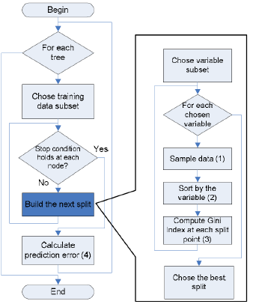
Random Forest Flow Chart

Slide 17
Random Forest – Practical Consideration
Splits are chosen according to a purity measure:
E.g. squared error (regression), Gini index (classification)
How to select N?
Build trees until the error no longer decreases
How to select M?
Try to recommend defaults, half of them and twice of them and pick the best

Slide 18
New Control Parameter N
Ntree, n_estimator (number of trees)
1 tree per bootstrap sample
Larger is better, but at some point useless
Helps avoid overfitting
Alleviates need for pruning trees through bagging
Notes:
Feature selection:
-Select a minimum set of features such that the probability distribution of different classes given the values for those features is as close as possible to the original distribution given the values of all features
-reduce # of patterns in the patterns, easier to understand

Slide 19
New Control Parameter M
Mtrys, max_feature (size of variable subsets) control diversity
As M decreases -> trees are less correlated
(different splits, but not all node interactions)
As M increases -> trees are more correlated
(similar splits, more possible interactions)
Essentially, trade off in bias and variance
Defaults: M=√P for classification
M= P/3 for regression
Notes:
Feature selection:
-Select a minimum set of features such that the probability distribution of different classes given the values for those features is as close as possible to the original distribution given the values of all features
-reduce # of patterns in the patterns, easier to understand

Slide 20
A Tree or a Forest
Same as Classification/Regression Tree:
Need to find splits, build tree
Different than Tree
In principle new parameters maybe easy to set:
ntree, can just get large
node size (ie bucket size), can just be set low
mtry, not obvious but sqrt(P) or P/3 seems good
Variable importance is new measure
Performance less sensitive to particular points (lower variance), smoother decision thresholds
More computation
Less interpretable (no final tree to visualize!)
Aggregating over an ensemble reduces prediction variance
Notes:
Feature selection:
-Select a minimum set of features such that the probability distribution of different classes given the values for those features is as close as possible to the original distribution given the values of all features
-reduce # of patterns in the patterns, easier to understand

Slide 21
In R: randomForest
R code:
install.packages("randomForest")library("randomForest")
tree_result=randomForest(X,as.factor(Y),
ntree=100, #number of trees
mtry=sqrt(P), #number of variables to sample
importance=T, #estimate importance
nodesize=1); #number of example at each node

Slide 22
In Python
class sklearn.ensemble.RandomForestClassifier(n_estimators=10, criterion='gini', max_depth=None, min_samples_split=2, min_samples_leaf=1, min_weight_fraction_leaf=0.0, max_features='auto', max_leaf_nodes=None, bootstrap=True, oob_score=False, n_jobs=1, random_state=None, verbose=0, warm_start=False, class_weight=None)
http://scikit-learn.org/stable/modules/generated/sklearn.ensemble.RandomForestClassifier.html
Notes:
Parameters:n_estimators : integer, optional (default=10)
The number of trees in the forest.
criterion : string, optional (default=”gini”)
The function to measure the quality of a split. Supported criteria are “gini” for the Gini impurity and “entropy” for the information gain. Note: this parameter is tree-specific.
max_features : int, float, string or None, optional (default=”auto”)
The number of features to consider when looking for the best split:
If int, then consider max_features features at each split.
If float, then max_features is a percentage and int(max_features * n_features) features are considered at each split.
If “auto”, then max_features=sqrt(n_features).
If “sqrt”, then max_features=sqrt(n_features).
If “log2”, then max_features=log2(n_features).
If None, then max_features=n_features.
Note: the search for a split does not stop until at least one valid partition of the node samples is found, even if it requires to effectively inspect more than max_features features. Note: this parameter is tree-specific.
max_depth : integer or None, optional (default=None)
The maximum depth of the tree. If None, then nodes are expanded until all leaves are pure or until all leaves contain less than min_samples_split samples. Ignored if max_leaf_nodes is not None. Note: this parameter is tree-specific.
min_samples_split : integer, optional (default=2)
The minimum number of samples required to split an internal node. Note: this parameter is tree-specific.
min_samples_leaf : integer, optional (default=1)
The minimum number of samples in newly created leaves. A split is discarded if after the split, one of the leaves would contain less then min_samples_leaf samples. Note: this parameter is tree-specific.
min_weight_fraction_leaf : float, optional (default=0.)
The minimum weighted fraction of the input samples required to be at a leaf node. Note: this parameter is tree-specific.
max_leaf_nodes : int or None, optional (default=None)
Grow trees with max_leaf_nodes in best-first fashion. Best nodes are defined as relative reduction in impurity. If None then unlimited number of leaf nodes. If not None then max_depth will be ignored. Note: this parameter is tree-specific.
bootstrap : boolean, optional (default=True)
Whether bootstrap samples are used when building trees.
oob_score : bool
Whether to use out-of-bag samples to estimate the generalization error.
n_jobs : integer, optional (default=1)
The number of jobs to run in parallel for both fit and predict. If -1, then the number of jobs is set to the number of cores.
random_state : int, RandomState instance or None, optional (default=None)
If int, random_state is the seed used by the random number generator; If RandomState instance, random_state is the random number generator; If None, the random number generator is the RandomState instance used by np.random.
verbose : int, optional (default=0)
Controls the verbosity of the tree building process.
warm_start : bool, optional (default=False)
When set to True, reuse the solution of the previous call to fit and add more estimators to the ensemble, otherwise, just fit a whole new forest.
class_weight : dict, list of dicts, “auto”, “subsample” or None, optional
Weights associated with classes in the form {class_label: weight}. If not given, all classes are supposed to have weight one. For multi-output problems, a list of dicts can be provided in the same order as the columns of y.
The “auto” mode uses the values of y to automatically adjust weights inversely proportional to class frequencies in the input data.
The “subsample” mode is the same as “auto” except that weights are computed based on the bootstrap sample for every tree grown.
For multi-output, the weights of each column of y will be multiplied.
Note that these weights will be multiplied with sample_weight (passed through the fit method) if sample_weight is specified.

Slide 23
Features and Advantages
The advantages of random forest are:
It is one of the most accurate learning algorithms available. For many data sets, it produces a highly accurate classifier
It runs efficiently on large databases
It can handle thousands of input variables without variable deletion
It gives estimates of what variables are important in the classification
It generates an internal unbiased estimate of the generalization error as the forest building progresses
It has an effective method for estimating missing data and maintains accuracy when a large proportion of the data are missing
Notes:
t has methods for balancing error in class population unbalanced data sets
Generated forests can be saved for future use on other data
Prototypes are computed that give information about the relation between the variables and the classification
It computes proximities between pairs of cases that can be used in clustering, locating outliers, or (by scaling) give interesting views of the data
The capabilities of the above can be extended to unlabeled data, leading to unsupervised clustering, data views and outlier detection
It offers an experimental method for detecting variable interactions

Slide 24
Disadvantages
Random forests have been observed to overfit for some datasets with noisy classification or regression tasks
For data including categorical variables with different number of levels, random forests are biased in favor of those attributes with more levels
Therefore, the variable importance scores from random forest are not reliable for this type of data

Slide 25
Additional information
Estimating the test error:
While growing forest, estimate test error from training samples
For each tree grown, 33-36% of samples are not selected in bootstrap, called out of bootstrap (OOB) samples
Using OOB samples as input to the corresponding tree, predictions are made as if they were novel test samples
Through book-keeping, majority vote (classification), average (regression) is computed for all OOB samples from all trees
Such estimated test error is very accurate in practice, with reasonable N

Slide 26
Summary
Extremely fast
Fast to build - even faster to predict
Practically speaking, not requiring cross-validation alone for model selection significantly speeds training by 10x-100x or more
Fully parallelizable
Automatic predictor selection from large number of candidates
Resistance to over training
Ability to handle data without preprocessing
data does not need to be rescaled, transformed, or modified
resistant to outliers
automatic handling of missing values
Cluster identification can be used to generate tree-based clusters through sample proximity

Slide 27
New Measures of Variable Importance
Bootstrap samples leave out some data points
Use these OOB (out of bag) points for testing
For each node in each tree:
, record OOB predictions
permute values and record OOB prediction
VI_{i} = AVE_{trees}(%correct before permuting –
%correct after permuting
Note: node importance calculated during tree construction is related to first term
Notes:
Feature selection:
-Select a minimum set of features such that the probability distribution of different classes given the values for those features is as close as possible to the original distribution given the values of all features
-reduce # of patterns in the patterns, easier to understand

